Slide 1
Cromarty Youth Café Report for Community Council - February 2023

Slide 2
Numbers
Contacts – 312
Learning Hours – 417
Programmed Activities – 24

Slide 3
Partnerships
Ward Manager – Funding & Opportunities & Partnership with Elected members
Highland Council Modern Apprenticeship team meeting – planning – parent nights, employability day – mock interviews etc
Fortrose Academy
Generations Working Together
Community Councils across the Black Isle
Tesco Food Share weekly support classes and Cookwell / Bakewell
Black Isle Cares – Intergenerational Sessions
Fortrose Library Staff – Getting to Know Your Techno
ASC – HLH Leadership, Courses & Classes
HSCN – IG Session & Planning
7 primary schools from Across the ASG - Resilient Kids underway
Well-Being on the Black Isle group partners
British Army- Sargent Sammy O’Gordon
Creativity in Care
Ronald Young from Cromarty First Responder
Ronald Young from Cromarty Fire & Rescue

Slide 4
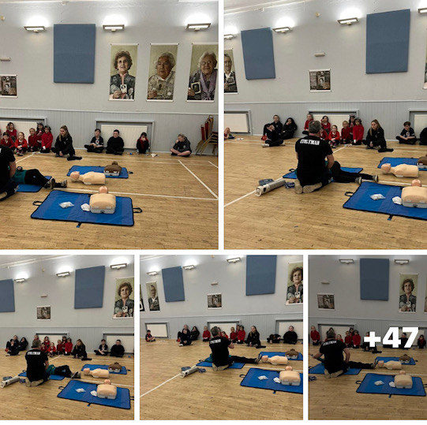
Basic First Aid Training with Local First Responder
Huge thank you 🙏 to our local
First Scottish Ambulance Responder ⛑️- Ronnie Responder who delivered Basic First Aid training at Youth Cafe the session with both Jnrs and Snrs included Dr s A B C , CPR ,Recovery position and yes our Young leaders enjoyed a wee nap 😴 💤
A number of our young people identified Ronald as a go to person that helps others in his Fire 🔥 Truck and at the harbour #CommunitySafety #cromartyfirebrigade #scottishambulance

Slide 5
Get Heard Participation Forums – Meeting YP Weekly
Cromarty and District Community Council - Youth Councillor Dom Scott Lodge
Meet with Local Councillors Lyndsay Johnston & Sarah Aitkin Monthly
HYP x 3 Reps
SYP x 1 Rep
Health and Well Being Focus Group school and community
Mental Health Ambassadors at planning stage seeking 2 yp from each year group
Cromarty Youth Café Youth Committee
Youthwork Lunchtime sessions
Cromarty Community Rowing Club
Sports Scotland Sports Ambassadors x 2

Slide 6
Football Coaching with ICT
Weekly football session with two coaches from Inverness Caley Thistle with approx. 20 people attending each week,
2 of our Young Leaders are playing for Caley Thistle Youth Team
Each week young people are building on their:
Skills
Team work
Communication
And love at the end of the session, they look forward to mini matches, unfortunately there are a few young people who are sore looser, but we are working on this.

Slide 7
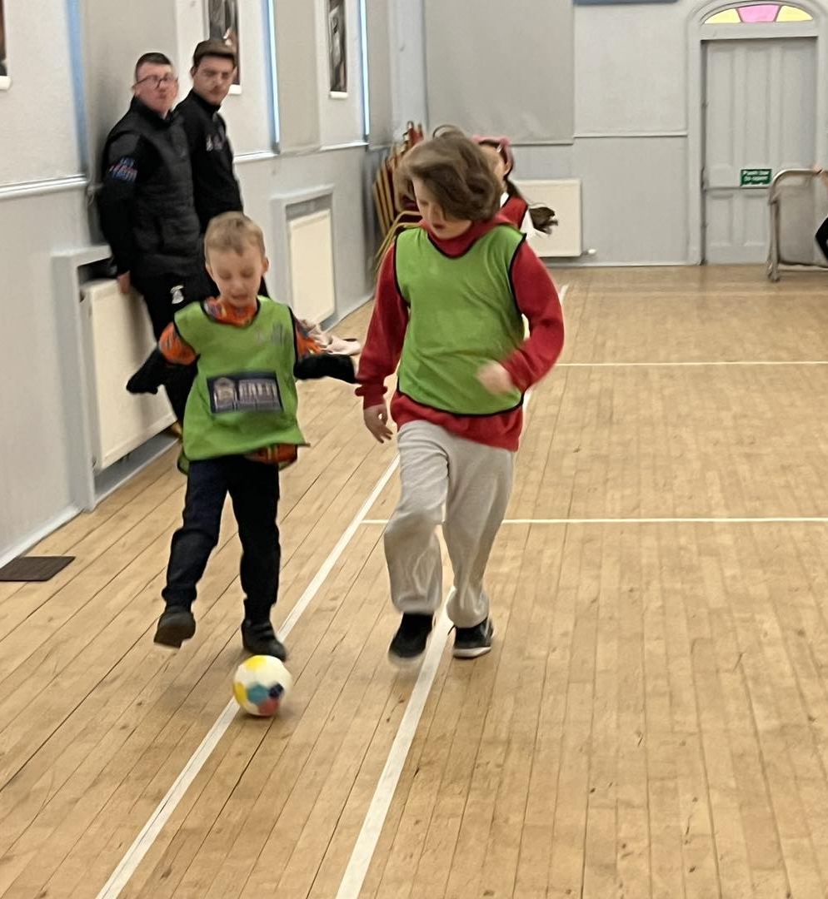
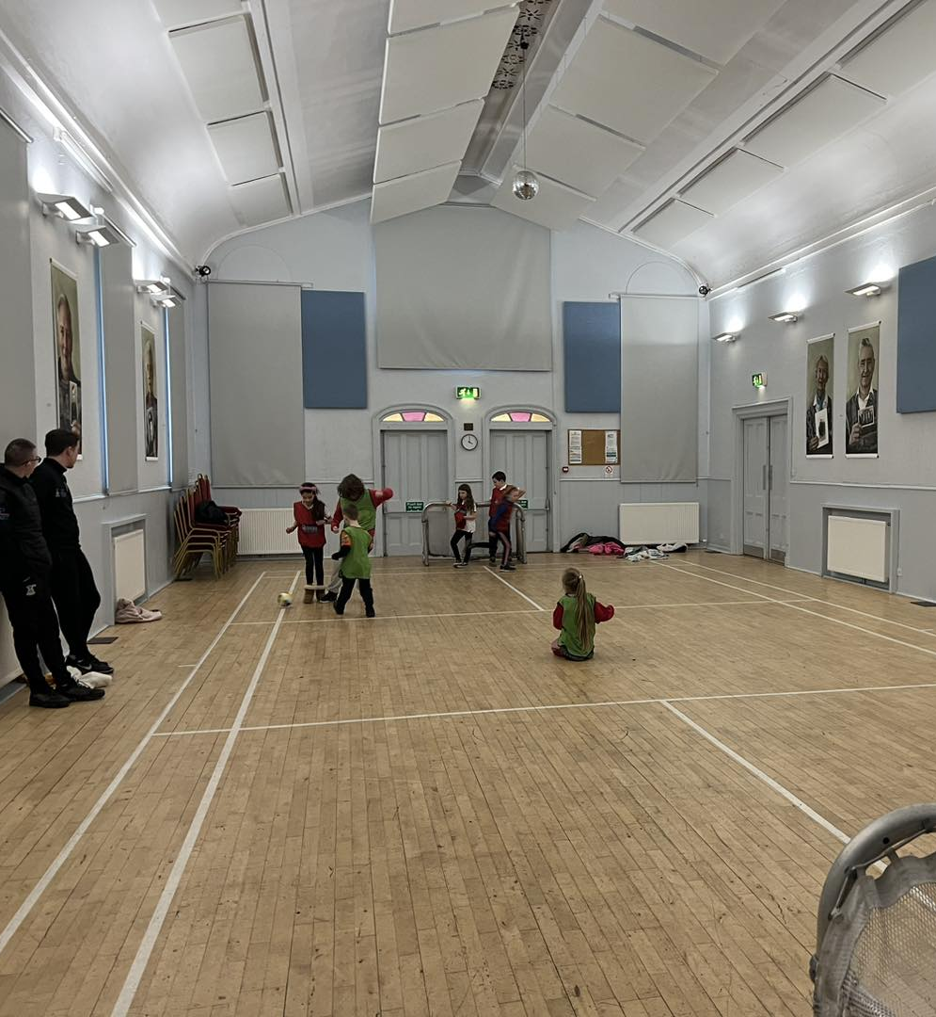

Slide 8
Saltire Awards & HLH Leadership
At every activity we provide, there are young volunteers and HLH leaders, they plan, deliver and evaluate each session.
Whilst volunteering and or leading young people are telling us they are gaining skills for life, building confidence, self esteem and in turn supporting young people to be the best version of themselves.
This month has saw a number of challenges with behaviour and the needs of young people, we have revisited the Youth Café Code of Conduct, that was created by young people for young people

Slide 9
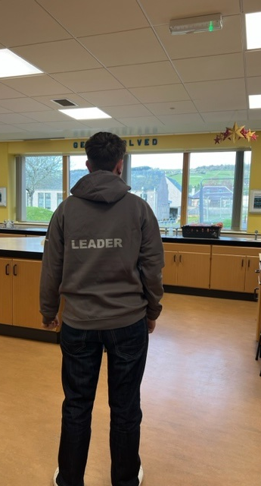
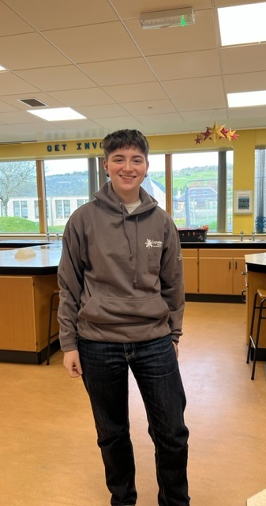
This is Dom Scott-Lodge after receiving his Silver HLH Leadership Hoody for 250 hours of leadership

Slide 10
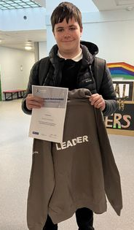
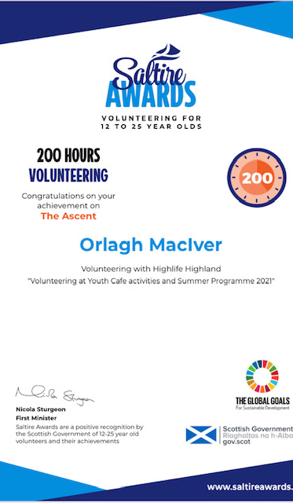

Slide 11
Choose to Lead Level 4
20 young people are taking part in the Highlife Highland Choose to Lead Level 4 Award (SCQF Rated Level 4)
The choose to lead award focus’s on Young people planning, preparing, delivering & then evaluating the session.
These sessions will be delivered at Multi-Sports, After school clubs, Rowing & Youth Café, a number of young people who are taking part in Choose to Lead are taking part in Intergenerational sessions
Young people need to deliver 40 hours of their time to gain the award and they need approx. 40 hours to fill in the booklet and need to create a portfolio.
This is ran by Wanda in partnership with the University of Inverness (UHI)

Slide 12
Athletics Club
New Club started at the beginning of February ran by local young leader Layla
This was Layla’s first experience of delivering classes, she found it stressful at the start but her confidence has now grown
Layla has enjoyed offering young people the opportunity to try something new and different,
Young people enjoyed the sessions and are looking forward to more sessions happening.

Slide 13
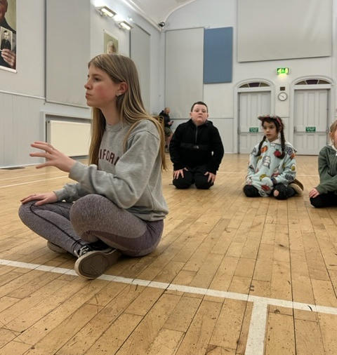
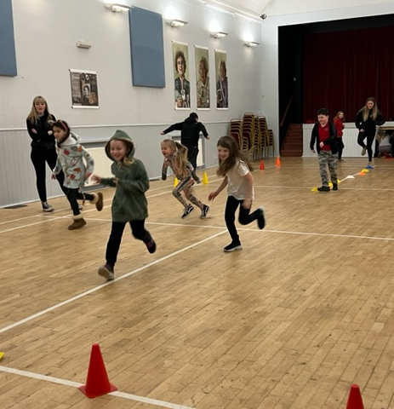
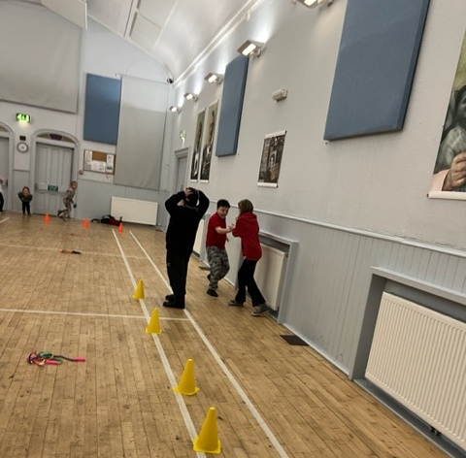

Slide 14
Food At Cromarty Youth Café
At every activity we provide, young people are offered a selection of sandwiches, hot meals fresh fruit, selection of Homebaking.
In 2022 over 3000 meals and or wellbeing bags were given to young people and vulnerable members of the community.
So far this year we have provided food to over 400 younger and older people.

Slide 15
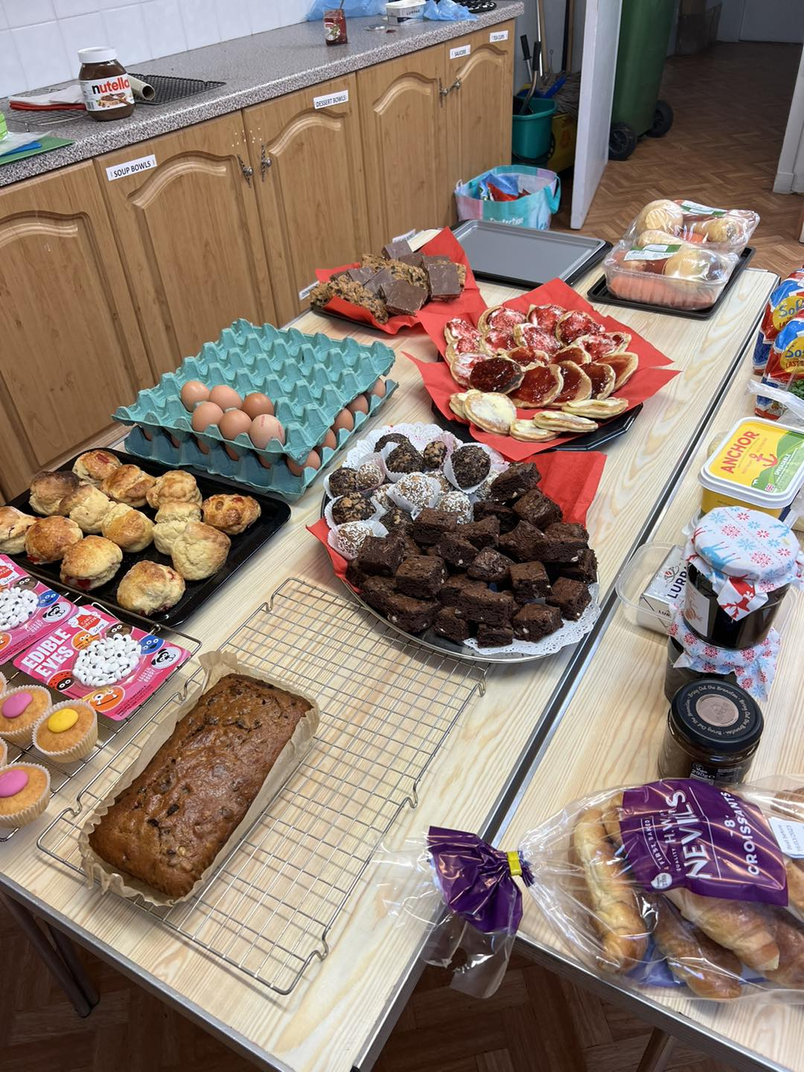
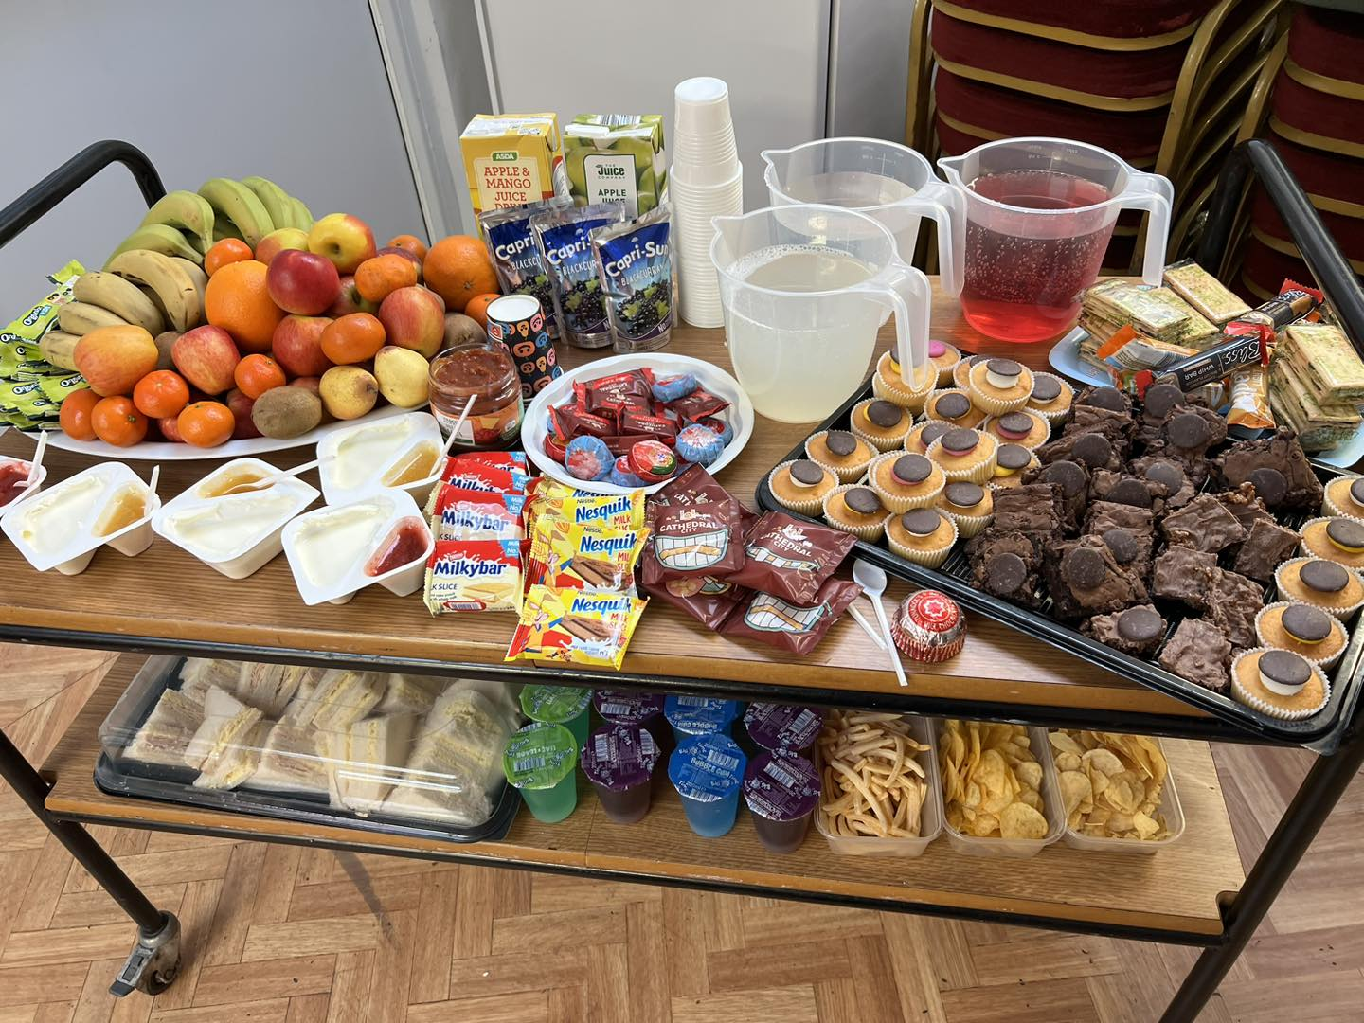
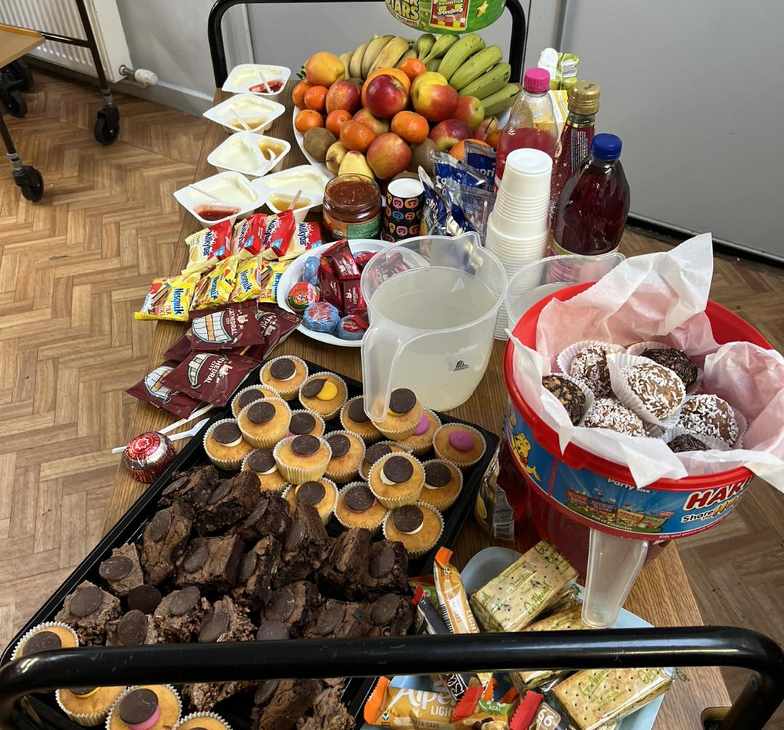
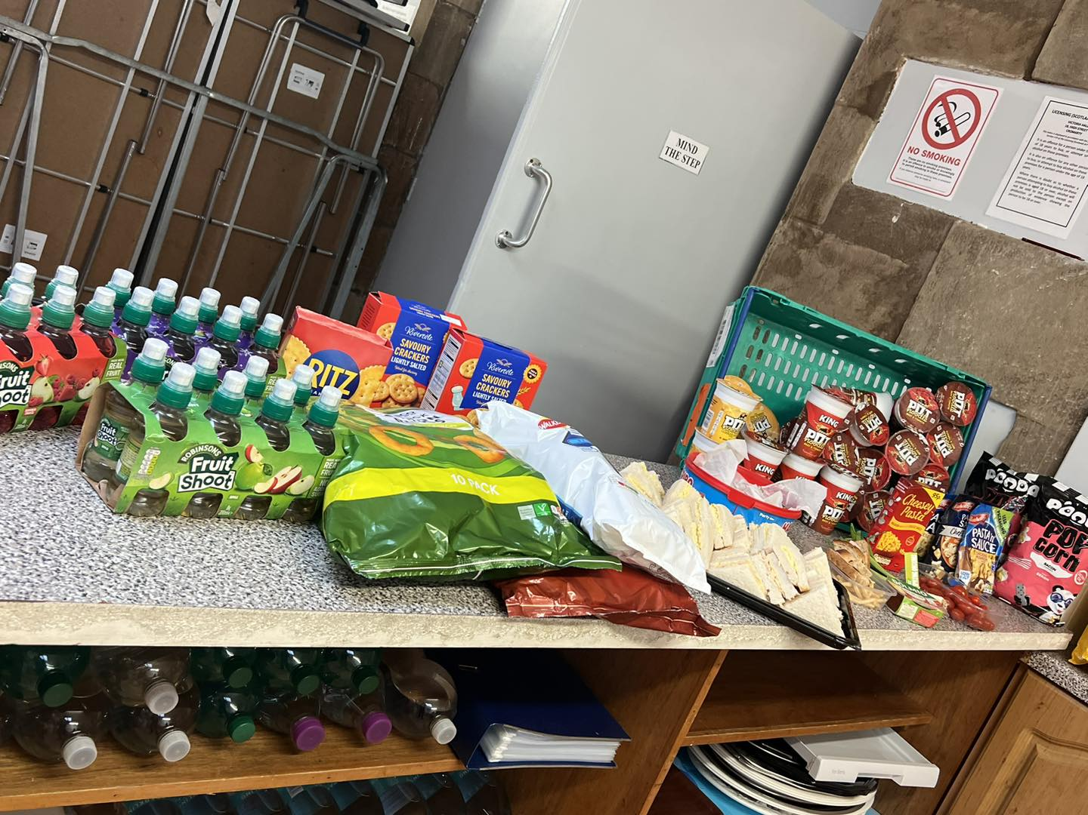

Slide 16
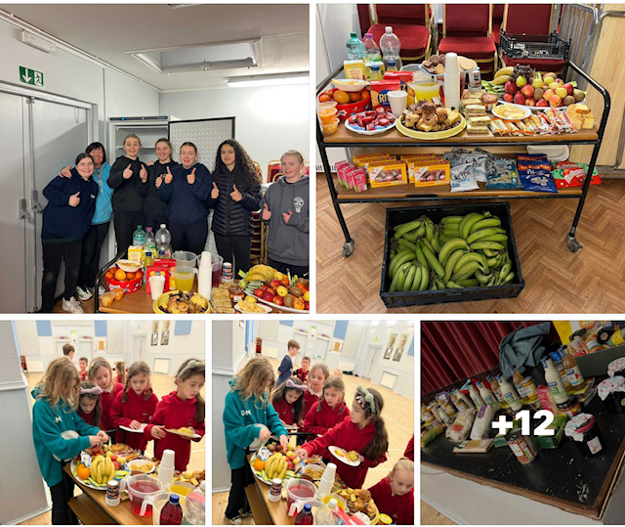
Thank you so much to Mike and Jason at Cfine for our new freezer Helping us to tackle food poverty together!
Huge thank you to Lynne Ogg and her team at Scotmid for their vouchers enabling us to provide snacks and refreshments at all Youth Cafe Sessions.
With our CFINE deliveries we:
Created Food hampers to give to younger and older people.
Young people doing doorstep deliveries and some stock went to the larders 😎

Slide 17
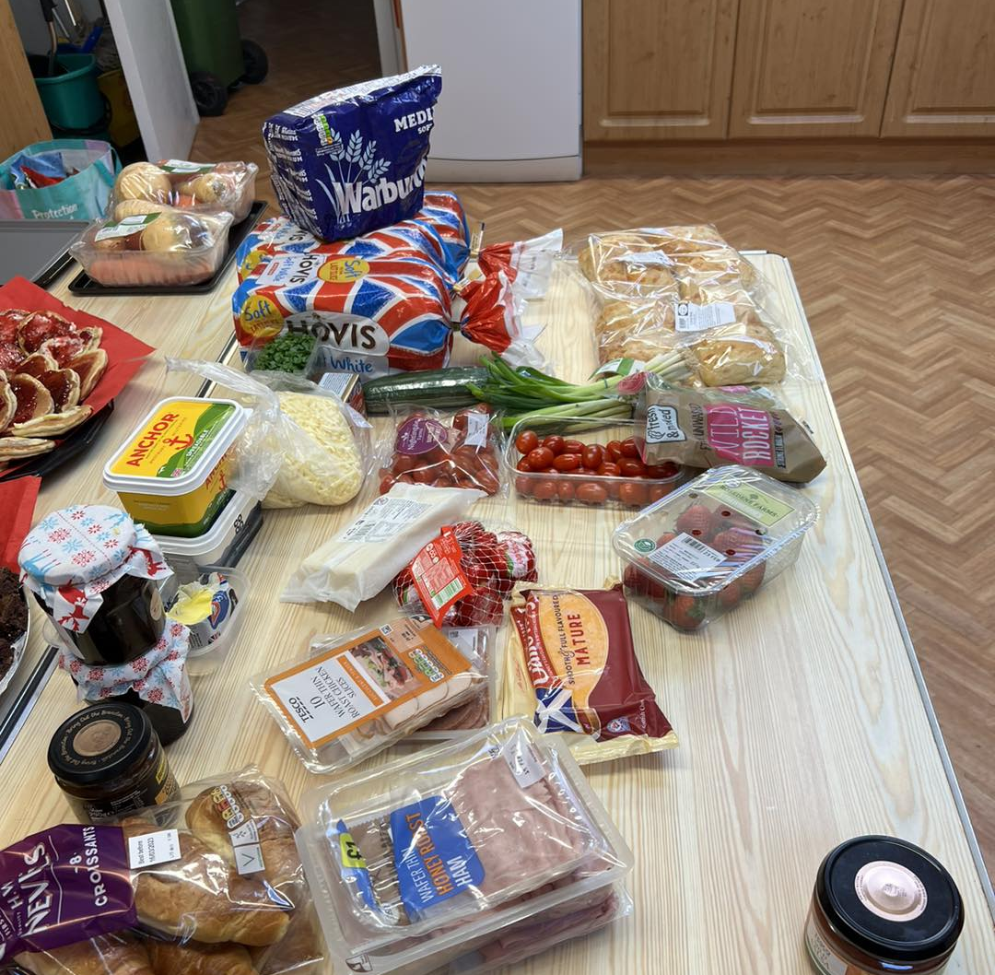
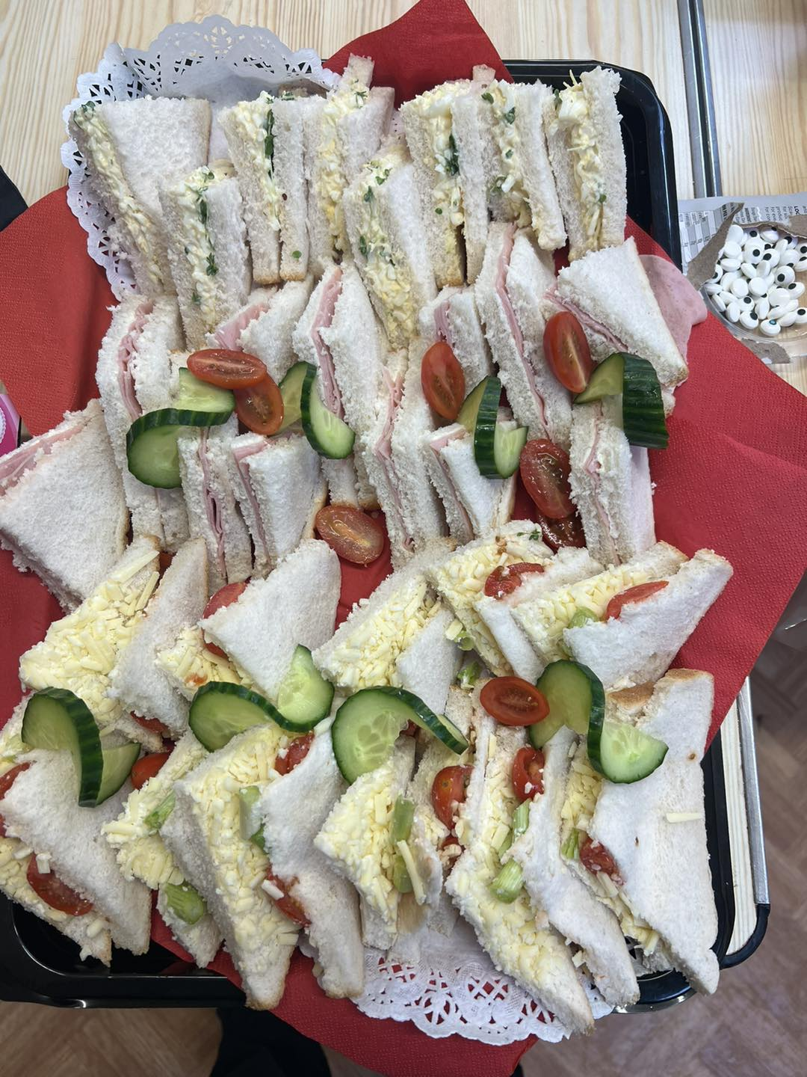
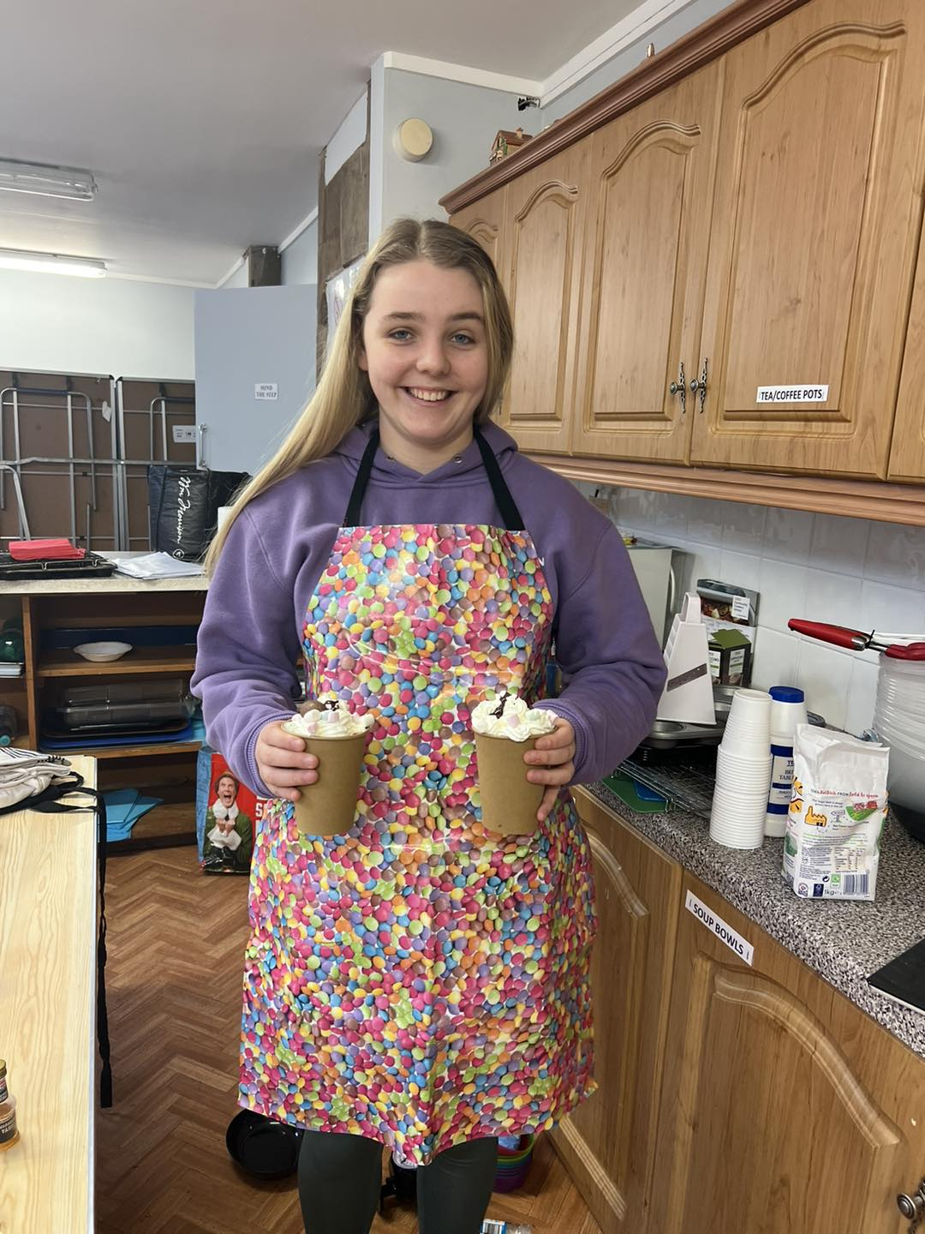

Slide 18
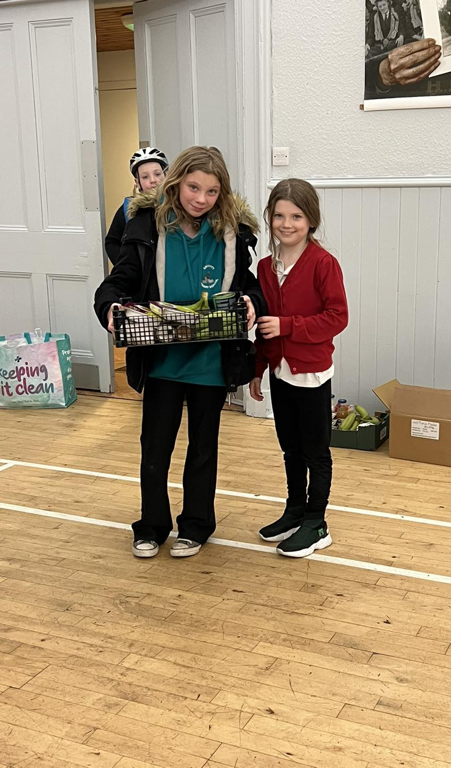
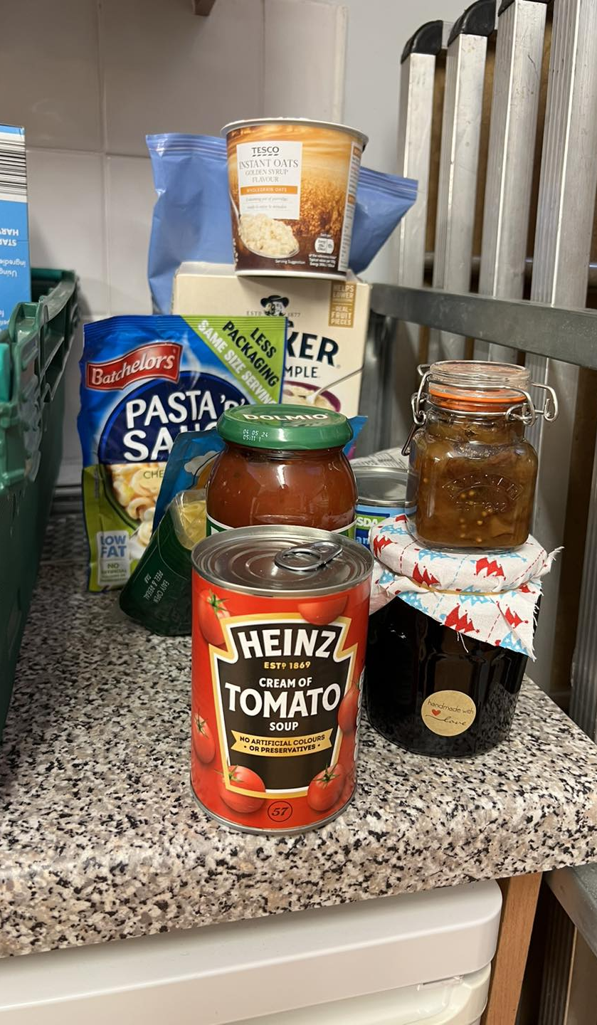

Slide 19
Jnr Youth Café
Games sessions including - Twister , Air Hockey , Ten Pin Bowling, Connect 4 , Lego Mania , Giant Dominoes , Snake & Ladders
Arts & Crafts
Creating Family Tree’s
Indoor Fluffy Snowball fights

Slide 20
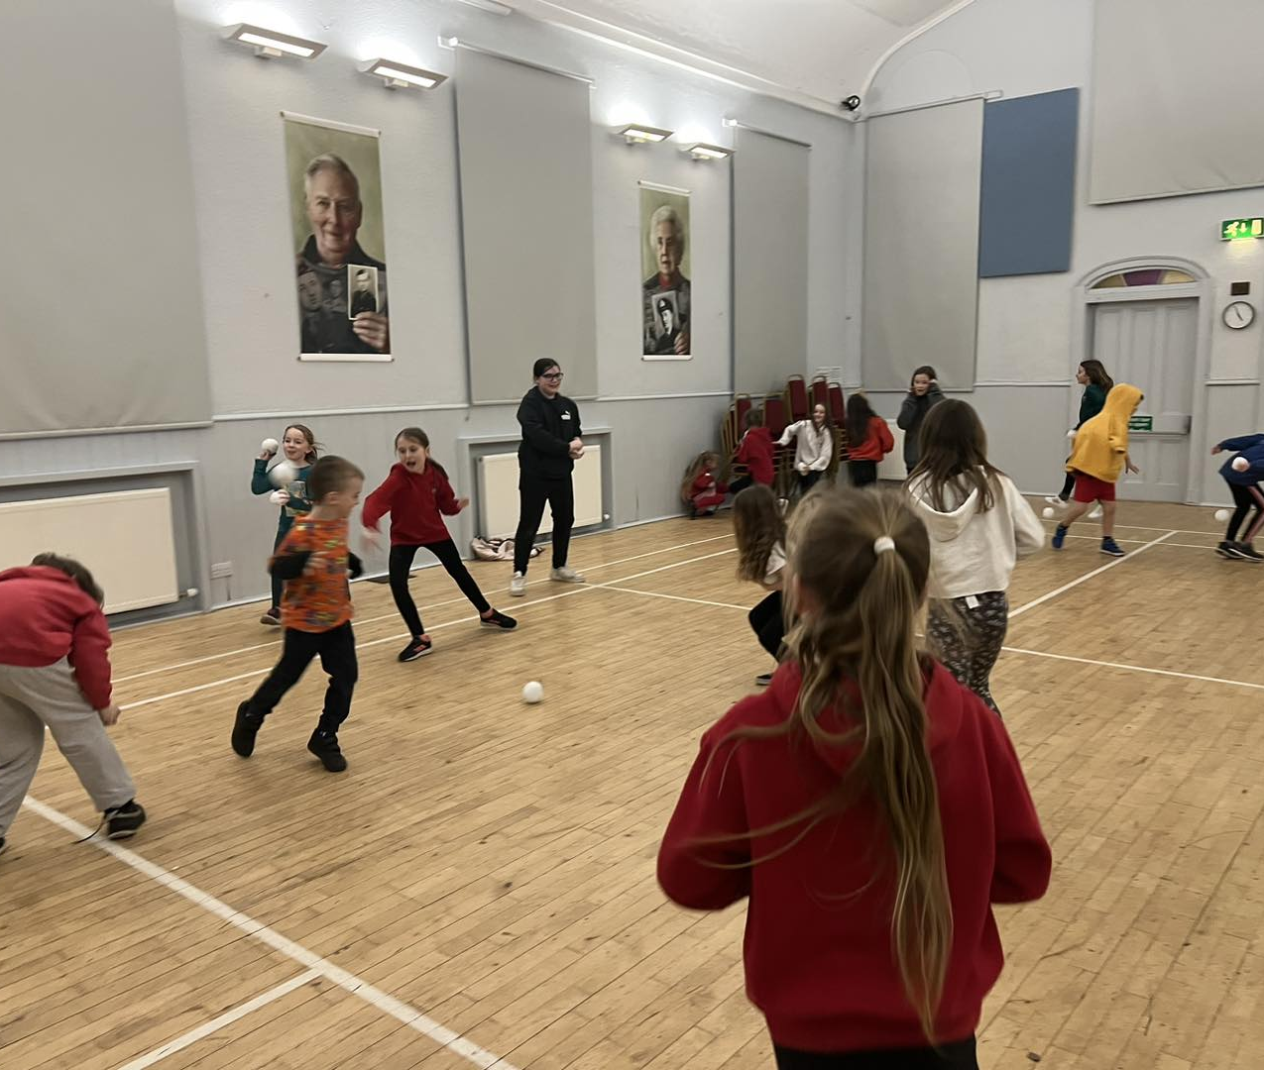
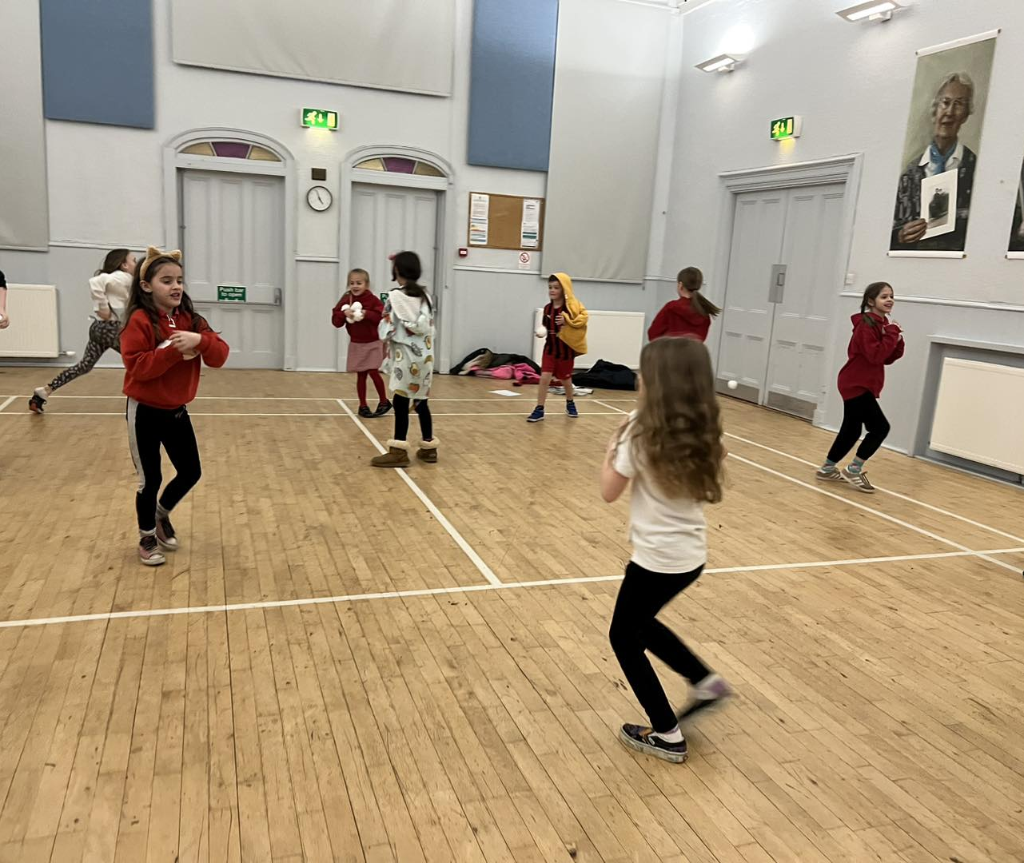
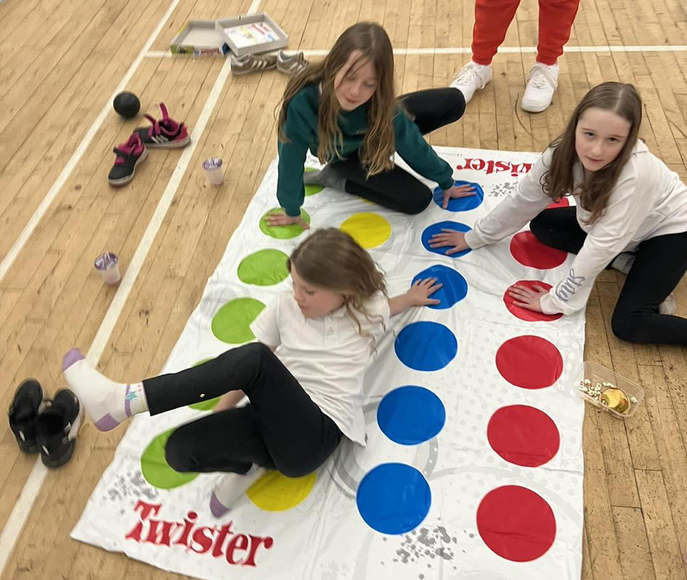
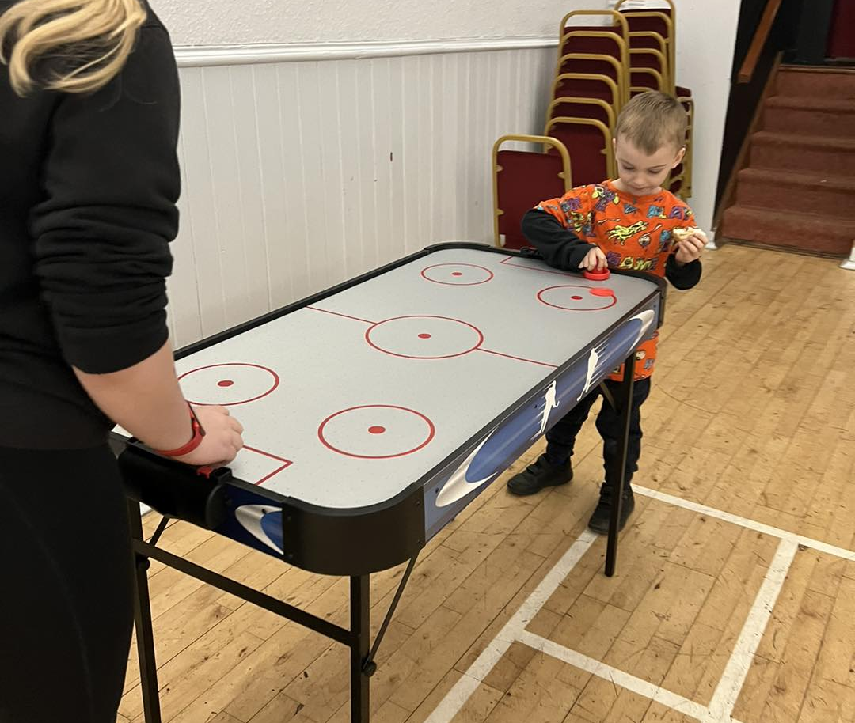
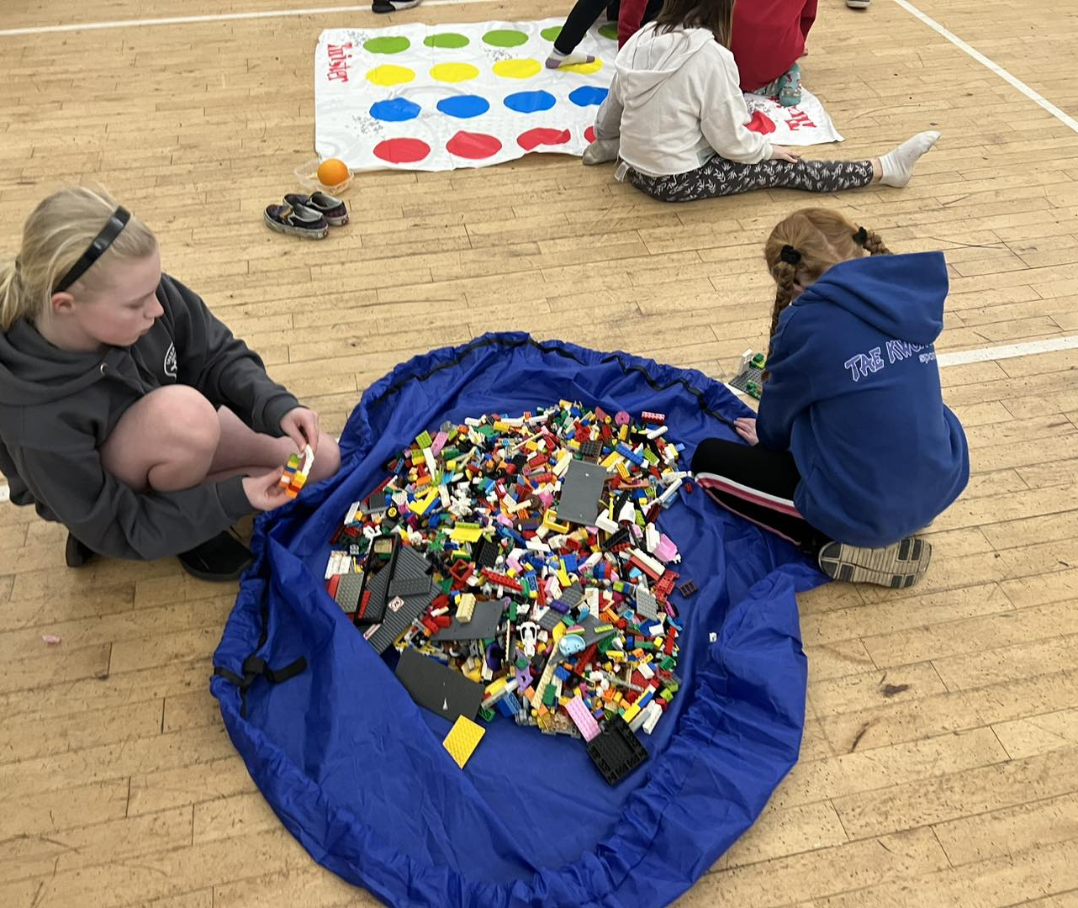
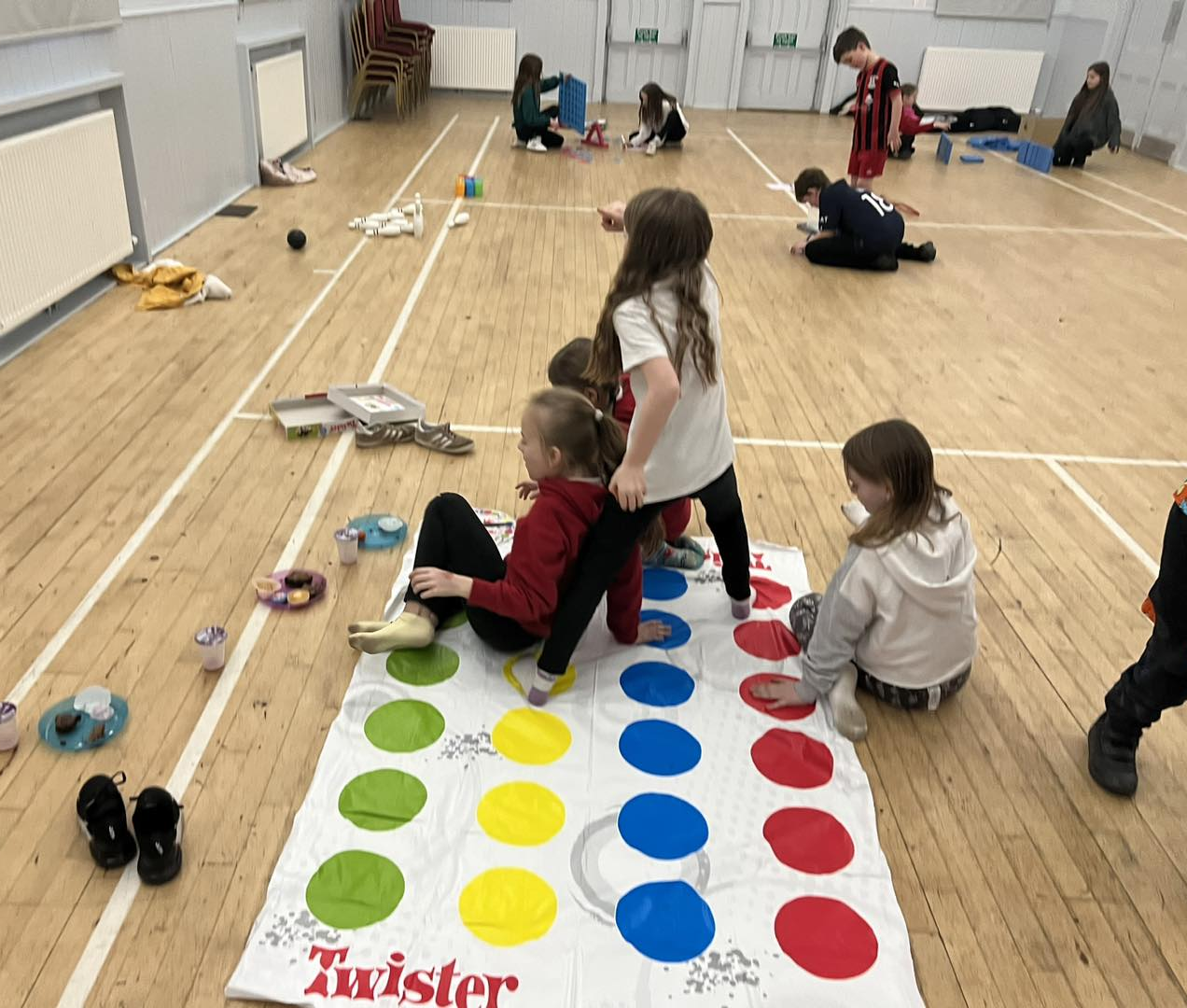

Slide 21
Snr Youth Café
Slime making
Completing their Inspire 2022 Booklets
Air hockey competitions
Indoor Rowing Time Races with Teagan
And at every session young people request Wanda’s Triple Chocolate Hot Chocolate with Mallows & Cream

Slide 22
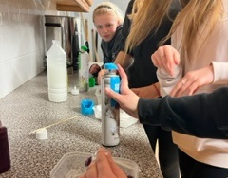
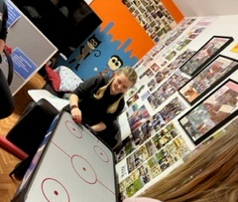
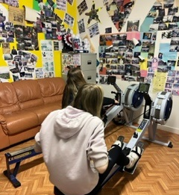
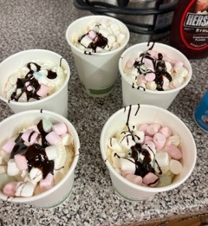

Slide 23
Inspire 2022 Dynamic Youth Award
After successfully receiving funding from Youth Scotland for the X-Treme Lego Christmas Party and well being bags for the older people,
Each young people has created a portfolio and completed their Dynamic Youth Award Booklet,
Their portfolios have been sent to Youth Scotland to be verified.

Slide 25
Creativity in Care Session’s
Fabulous session with Karrie and Chris from Creativity in Care and our budding young puppet makers enjoying taking part in The Hand-In-Hand puppetry story project as part of Windows of Reality project.
The project explores Belonging and Connectedness as a continuation of our compassionate communities (death, dying, grief) work and working towards our 2023 show which combines Highland covid-stories with puppetry.
It will share some of the knowledge and expertise that exists in our neighborhoods

Slide 26
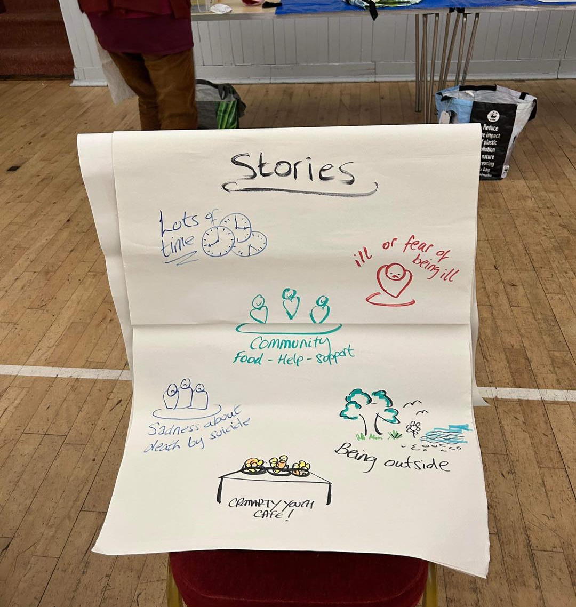
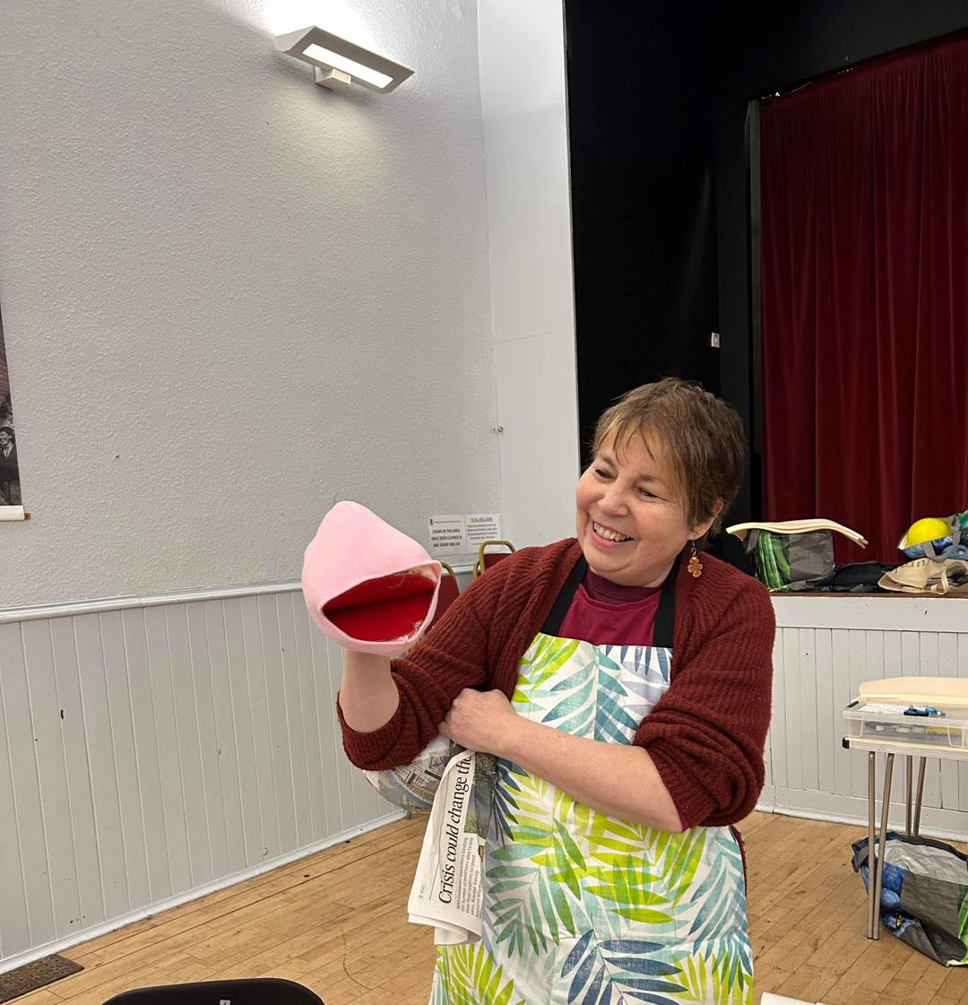
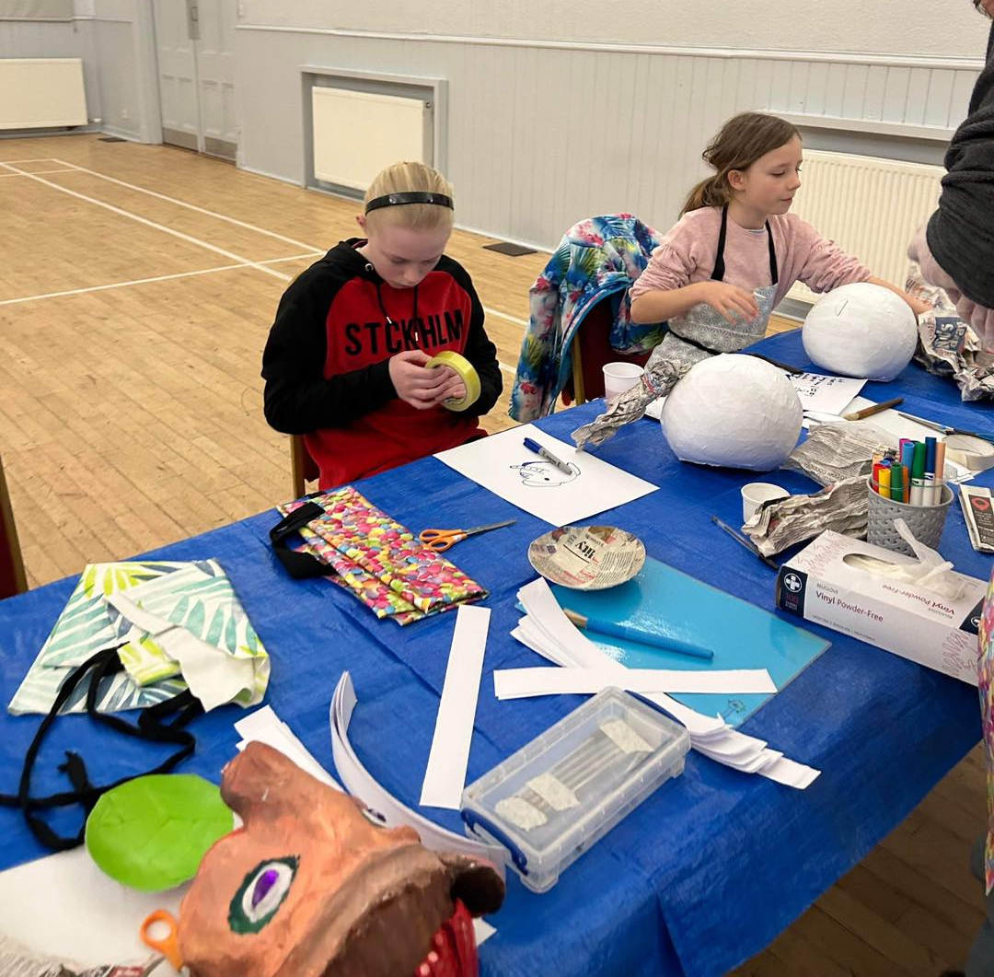

Slide 27
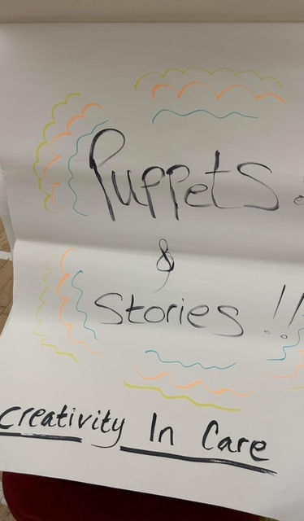
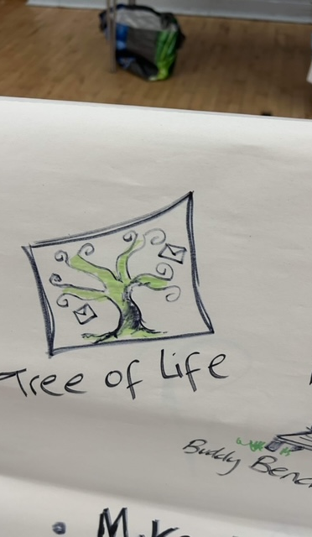
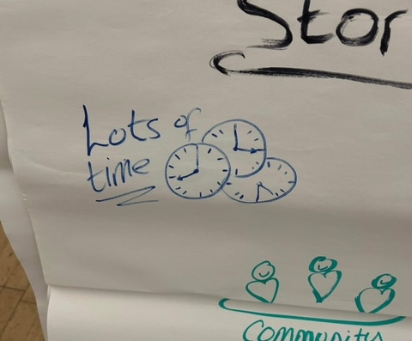
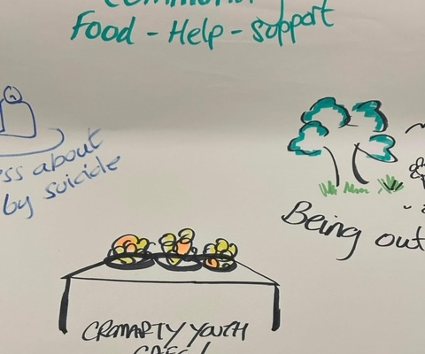

Slide 28
1-1s
Emotional Check-ins
Building confidence
Supporting YP to take part in school subjects
Young people are struggling with school work and exam pressures,
Young people are telling us they have low mood, feeling anxious.
Supporting YP to create CV, Fill in Job Applications & UCAS Applications
Supporting Young Carers
Working with Ukrainian Families
Cookwell / Bakewell

Slide 29
Careers Day at Fortrose Academy
At this event we were able to build new relationships with partner’s, enabling us to further support young people to a positive destination with employment or further education.
30 employers came in and joined us and young people for a business breakfast and then planned activities with all S3-S6. The feedback from the employers could not have been anymore positive about the pupils.
#positive #destination #ambition #respect

Slide 30
Resilient Kids: Moving Up
Over the past year I have been delivering the Resilient Kids Programme to all Primary 7’s across the Black Isle,
Resilient Kids: Moving Up is an Emotional Literacy Programme for Primary seven pupils. Through a group of six friends, the programme explores various issues and helps pupils to develop skills, build confidence and become more resilient.
I am going to be delivering this programme in Cromarty Primary School at the Start of March.

Slide 31
Funding:
Application submitted to Quaker Oats – Share the Warmth Campaign - £1,000
Application submitted to MFR Cash for Kids for Refreshments Costs & Cookwell Bakewell - £2,260
Application submitted to Black Isle Ward Budget to Run Summer Progamme - £10,00
Vulnerable Families given food and fuel vouchers (funding received in December) families will receive vouchers in Jan / Feb / March / April / May & June
Month on month we are completing funding applications to enable The Youth Café to provide fun session, activities , training and to be open to everyone and FREE
Application submitted to SPAR Community Fund for Youth Café Running Costs- £10,000
Application submitted to Mid Ross Cares for staffing costs - £10,000

Slide 32
Food Safety at Work Courses.
With funding from the Scottish Government, we were able to support:
45 people completed Level 1 Food Safety at Work
44 people completed Level 2 Food Safety at Work
These courses take at least 8 hours each to complete.
3 people completed Level 3 Food Safety at Work

Slide 33
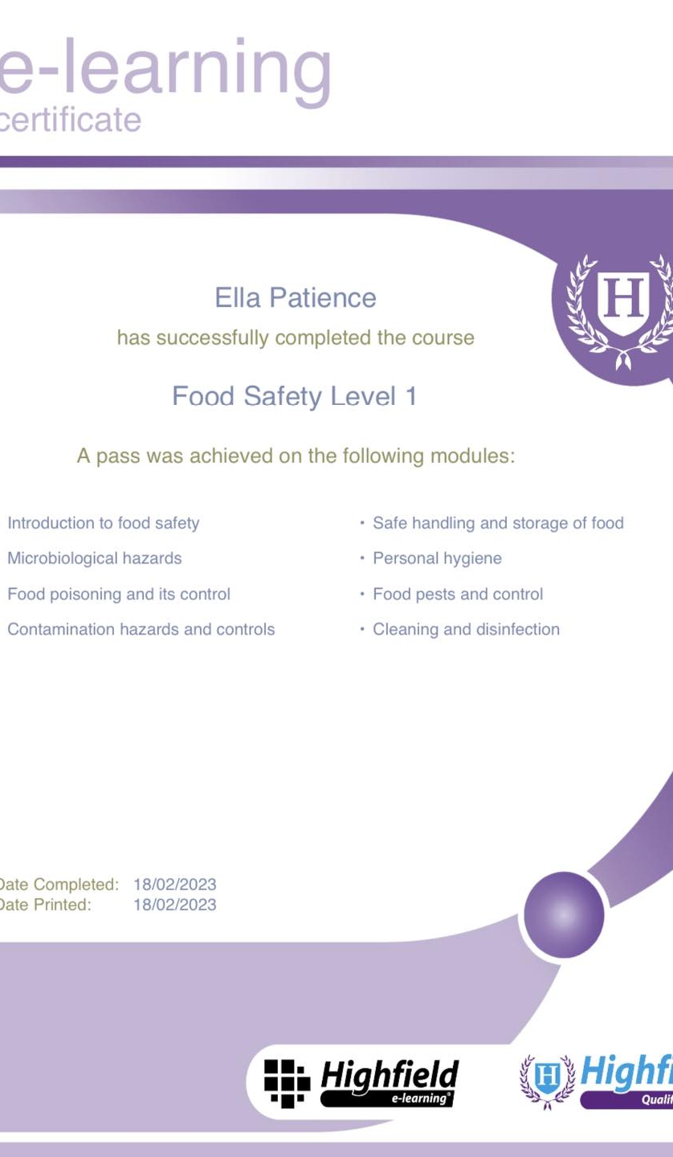
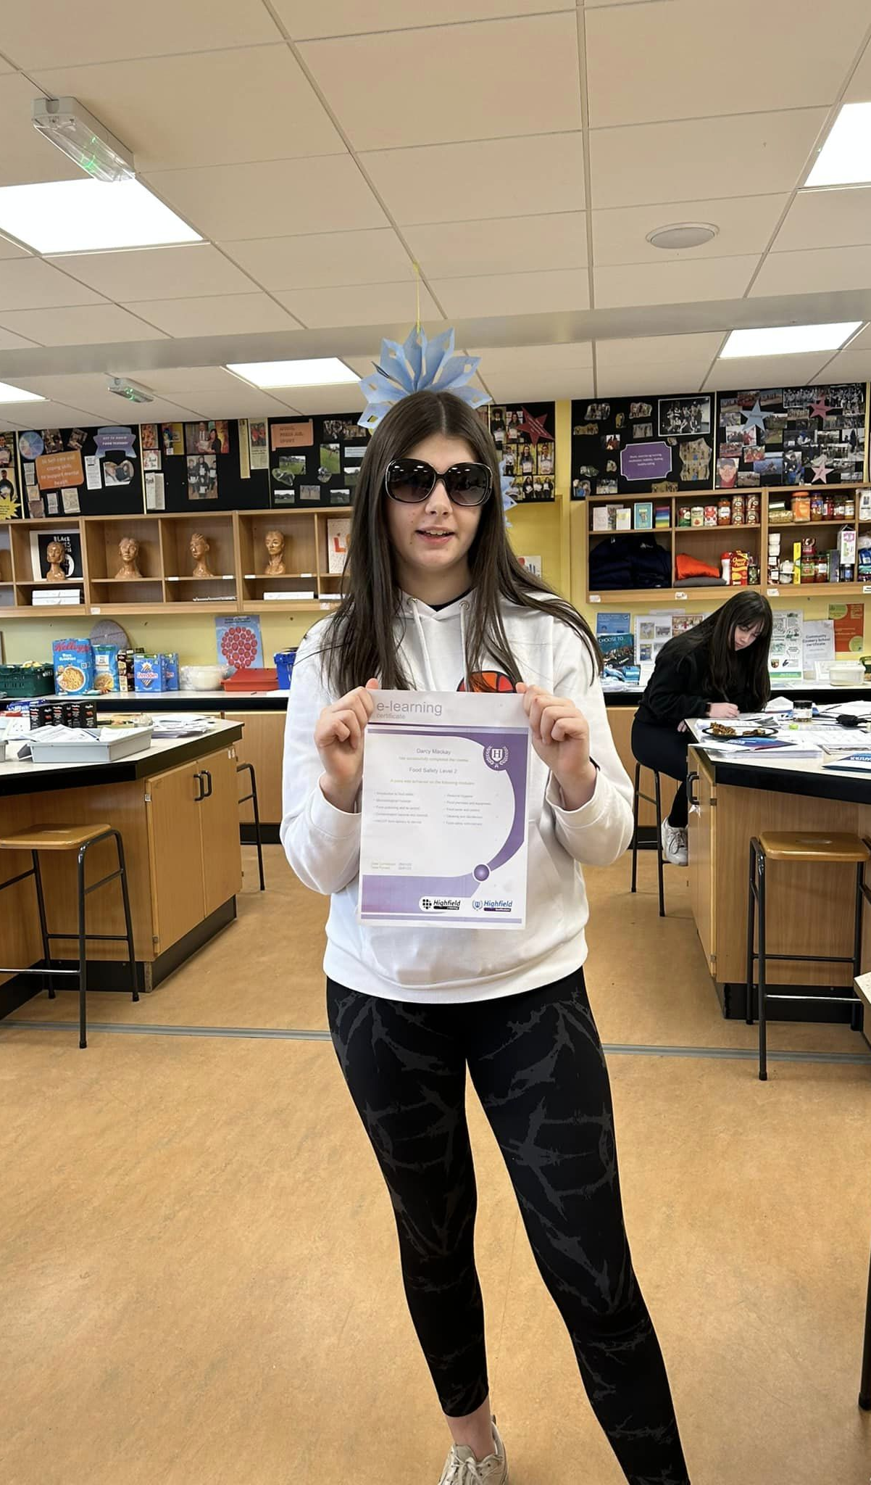
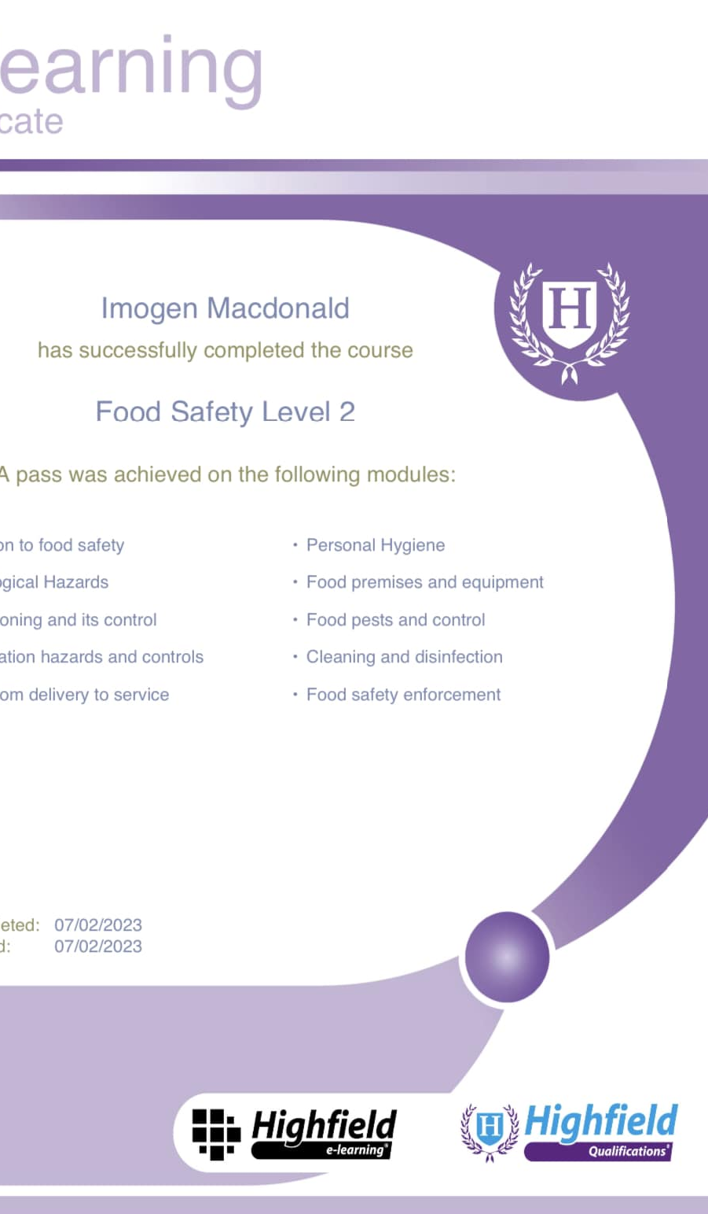

Slide 34
Cookwell & Bakewell
Each week we offer Cookwell & Bakewell sessions to young people.
Everything that is made at these classes is offered to other young people attending session and or given to vulnerable members of the community.
Young people taking part in these classes are learning new skills, how to budget, communication skills and teamwork skills.
Putting into practice what has been learned after taking complete Food Safety at work

Slide 35
Supporting Families
With funding from the CORRA Foundation we have been able support families in need,
Families were given a Fuel Voucher & Shopping Voucher
Families told us these vouchers have been a LIFELINE to them.

Slide 36
Coming up, over the next month we have a busy programme planned
Trip to Glasgow to Present at the Generations Working Together Conference
Presentation to NHS
Visit from Dunbar Grammar School
Easter Programme Planning & Preparing
Delivering Resilient Kids to P7’s in Cromarty Primary School
Creativity in Care Workshops
Young Carers Fundraiser (there is over 300 Young Carers in Ross-Shire
Jnr Youth Café Sessions
Snr Youth Café Sessions
Multi-Sports
Strike Day Provision
Progress our plans for the Kings Coronation

